Slide 1
Feminism
By: Hannah Whitlock, Charleigh Stepp, Emma Vann, & Anthea Walker

Slide 2
What is feminism?
Feminism is the basic belief that men and women should have equal rights.

Slide 3
What is feminism in Literary criticism?
Feminist Criticism is the reinforcement or undermining of women’s rights in literature
Literary criticism informed by feminist theory

Slide 4
How do you view literature from a literary standpoint?
You look at how the main woman role is being portrayed
Is she being undermined, is she the hero, what’s her whole role in the story?
How does this make women look?

Slide 5
When did feminist Criticism start?
Feminism started in the 1700s
Became very popular in the 1920s (womens suffrage)
Still continues to be a major topic today
Feminism became very popular in Western literature in the 1970s

Slide 6
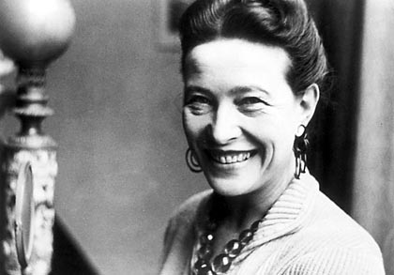
Critics/Founders
1948- Simone de Beauvoir wrote Le Deuxieme Sexe (The Second Sex). Many modern feminists base their beliefs on this book.

Slide 7
What is the feminism movement?
The feminist movement, refers to a series of campaigns regarding issues including women's suffrage, sexual harassment, reproductive rights, and sexual violence, and scrutiny in literary work, all falling under the label of feminism.

Slide 8
Authors Associated with Feminism
Emma de la Barra- Stella (1905) , Mecha Iturbe (1906)
Li Ang The Butcher’s Life (1983)
Zoe Nicholson- The Hungry Heart: A Woman’s Fast For Justice (2004), The passionate Heart,& Matri (2003)
Ellen Key The Education of the Child (1888) The Women Movement (1912)

Slide 9
Resources
http://bcs.bedfordstmartins.com/virtualit/poetry/critical_define/crit_femin.html
https://owl.english.purdue.edu/owl/resource/722/11/
http://www.unwomen.org/en
http://anthropology.ua.edu/cultures/cultures.php?culture=Feminist%20Anthropology
http://www.colorado.edu/Sociology/Mayer/Contemporary%20Theory/Feminist%20Theory_files/frame.htm

