Slide 1
Cultural Studies
Jason Hauch and Omar Mustafic

Slide 2
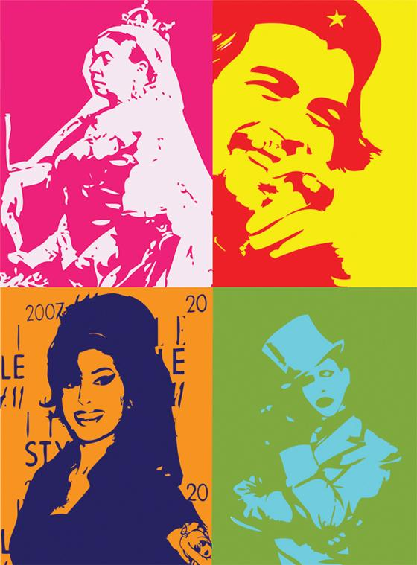
What is it?
Cultural studies is a type of literary criticism that aims to explain how literature affects us in our everyday lives

Slide 3
Years:
Cultural studies began in 1964 by British academics and was adopted by the rest of the world
It has continued to thrive and grow as a topic throughout the years
Today it is widely used to explain literatures affect on our lives

Slide 4
Founders:
The founder of Cultural Studies was Richard Hoggart
It was strongly associated with Stuart Hall, who educated Hoggart, in the 1960’s
Today, scholars from around the world continue with Cultural Studies and have transformed the topic greatly

Slide 5
Authors:
John Storey is a professor of cultural studies and has written seven books on the topic
Chris Barker is another author who has written four books on the topic
These two authors write about Cultural Studies for a living

Slide 6
Tenets of Belief:
Cultural studies began when scholars needed a way to examine how literature affects our everyday lives

Slide 7
Tenets of Belief Cont...
Read a book and think about how it affects our lives
Does this book change how we view male or females; our sense of class, other ethnicities and races, nationalities, or sexuality

Slide 8
Bibliography:
N.p., n.d. Web. 4 Mar. 2015.
"CULTURAL STUDIES." Literary Criticism. N.p., 22 Mar. 2013. Web. 04 Mar. 2015. <https://hakazekusaribe.wordpress.com/2013/03/22/cultural-studies/>.
"Welcome to the Purdue OWL." Purdue OWL: Literary Theory and Schools of Criticism. N.p., 1 Apr. 2012. Web. 04 Mar. 2015. <https://owl.english.purdue.edu/owl/resource/722/09/>.
N.p., 14 Dec. 2014. Web. 4 Mar. 2015. <http%3A%2F%2Fdocs.lib.purdue.edu%2Fcgi%2Fviewcontent.cgi%3Farticle%3D1169%26context%3Dclcweb>.

