Slide 1
Marxism: Literary Theory and Criticism
By: Karen Ye, Tobenna Egbochue, Steven Nguyen, and Frank Tang

Slide 2
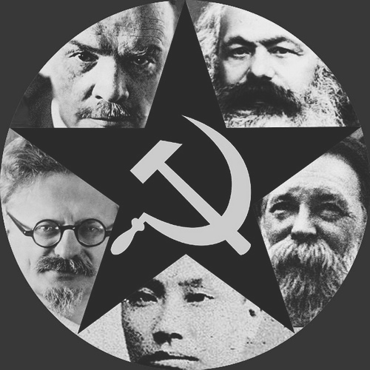
What is Marxism?
Marxism started approximately around the 1930’s and continues in a few countries across the world.
Most prominent during the Bolshevik Revolution of Russia
Fell out of favor with private property ideals and market-exchange system
Marxism today is mainly found in areas with contemporary communism, such as China, Vietnam, North Korea, Cuba, etc.

Slide 3
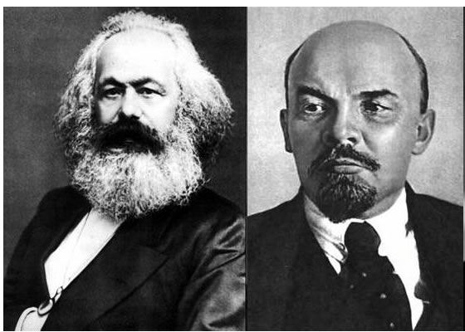
Founders and Critics
Founded by Karl Marx and Friedrich Engels
Founded under his dislike for the exploitation of proletariats by capitalism
Critics would be Vladimir Lenin
Formed Leninism and Marxism - Leninism from Marxism
Today, several countries practice a degree of Marxism
Countries like China, Vietnam, and Cuba
A handful of young workers around the world support Marxism as well

Slide 4
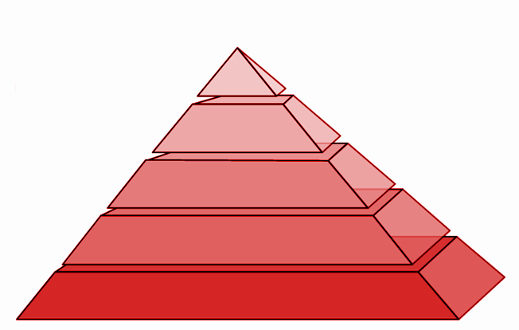
The Values of Marxism
Alienation
State or experience of isolation from a group or activity
Labor theory of value - the amount of production you accomplish will determine your worth
Example: (top to bottom in wealth and importance)
Factory worker
Agriculture Worker
Construction worker
Office worker
Congressman
Tobenna Egbochue
guys where the heck am i
why wasn’t i invited to the party
Frank Tang
Steven Nguyen
Factory Workers
Office Workers
Congressmen
President Jack Gayle

Slide 5
The Values of Marxism (cont.)
Materialist concepts - physical items (materials) contain more worth than spiritual items
Items hold more value to Marxists than people
This also means that the product that workers produce are worth more than the people producing it.
As long as a person continues to produce product, they are allowed to live, as people are worthless

Slide 6
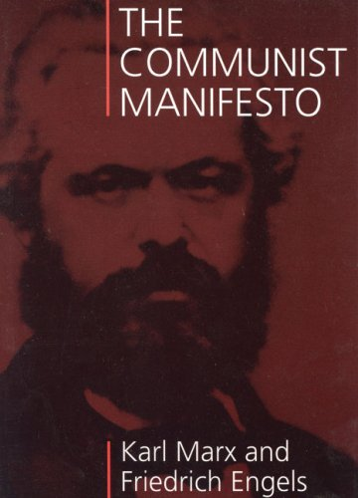
Authors Associated w/ Marxism
Karl Marx - (with Friedrich Engels) The Communist Manifesto, 1848; Das Kapital, 1867; "Consciousness Derived from Material Conditions" from The German Ideology, 1932; "On Greek Art in Its Time" from A Contribution to the Critique of Political Economy, 1859
Karl Marx wrote a lot; obviously he was the founder
Leon Trotsky - "Literature and Revolution," 1923
Georg Lukács - "The Ideology of Modernism," 1956
Louis Althusser - Reading Capital, 1965
Frederick Jameson - Marxism and Form, The Political Unconscious, 1971

Slide 7
Marxism in Literary Criticism
Discusses the themes (briefly)
Focuses primarily on class warfare of the characters in the story.
Oppression of characters
Giving power to the oppressed
eg. How the woman in the story asserts control instead of always listening to the man

Slide 8
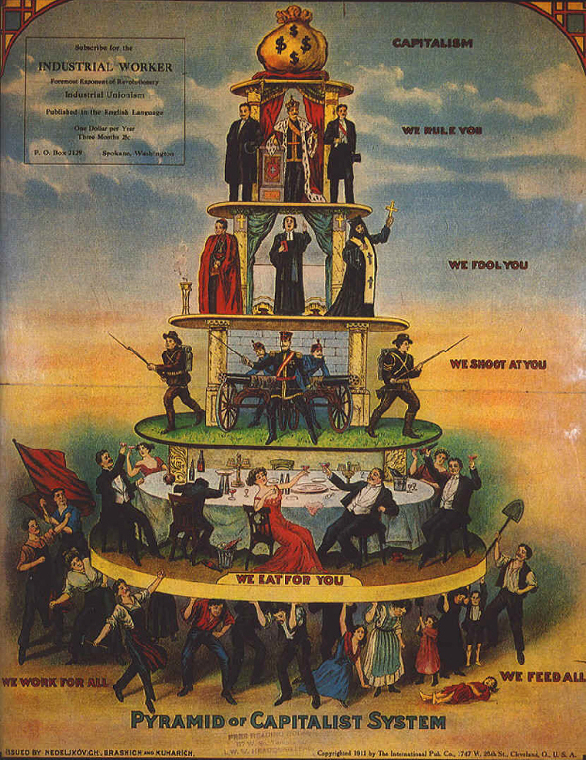
Questions to Ask
Whom does it benefit if the work or effort is accepted/successful/believed, etc.?
What is the social class of the author?
Which class does the work claim to represent?
What values does it reinforce?
What social classes do the characters represent?
How do characters from different classes interact or conflict?
How do the character’s social classes reflect his or her oppression or entitlement?

Slide 10
Bibliography
http://public.wsu.edu/~delahoyd/marxist.crit.html
Delahoyde, Michael. "Marxist Criticism." Marxist Criticism. N.p., n.d. Web. 04 Mar.. 2015.
https://www.marxists.org/archive/marx/works/1880/05/parti-ouvrier.htm
"The Programme of the Parti Ouvrier." Programme of the French Worker's Party. N.p., n.d. Web. 04 Mar. 2015.
http://www.nyu.edu/projects/ollman/docs/what_is_marxism.php
Ollman, Bertell. "What Is Marxism? A Bird's-Eye View." What Is Marxism? A Bird's-Eye View. N.p., n.d. Web. 04 Mar. 2015.
http://www.iep.utm.edu/literary/#H4
Brewton, Vince. "Internet Encyclopedia of Philosophy." Internet Encyclopedia of Philosophy. N.p., n.d. Web. 04 Mar. 2015.
http://plato.stanford.edu/entries/marx/
Wolff, Jonathan. "Karl Marx." Stanford University. Stanford University, 26 Aug. 2003. Web. 04 Mar. 2015.

