Slide 1
Modernism
BB
By: Ansel Ahabue, Mason Verdi, and Brian Markley
Go along with the current!

Slide 2
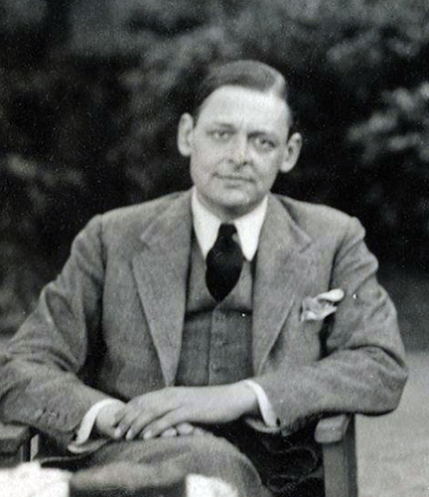
Modernism
Modernism is literature of the inner self and stream of consciousness.
Modernist’s stories have lots of irony and call out society's flaws.
Also, their stories seem to be going no way and have no plot, whereas most stories have a beginning, middle, and end.

Slide 3
Stream of Consiousness
Modernist art pioneered an unusual style.
Books like Ulysses had rapid flows of POVs, and thoughts were conveyed as they were.
Modernist books were meant to be revolutionary.

Slide 4
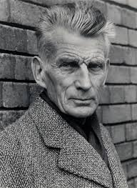
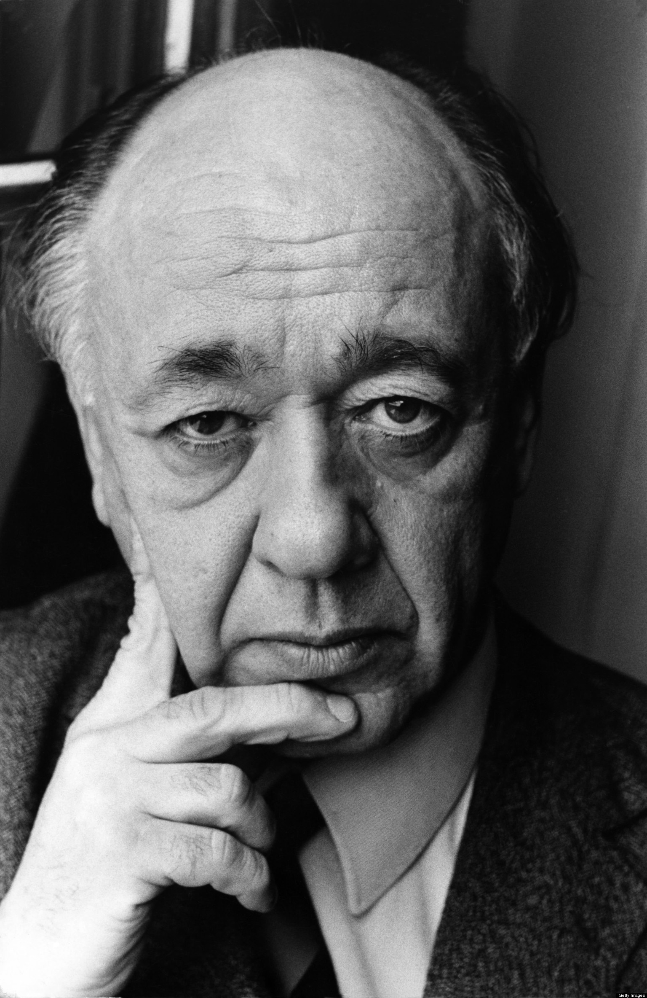
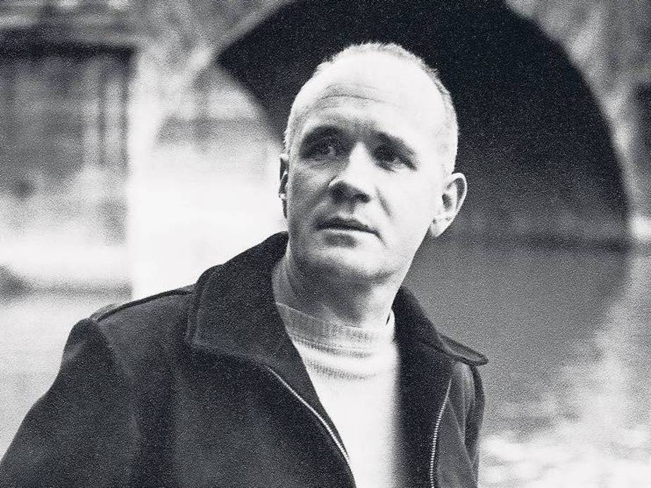
Theatre of the absurd
Modernism often employed a type of work called the “theatre of the absurd.”
This art form dealt with the futility of man’s endeavors and the prospect of a greater, diabolical force controlling the outcome of mankind: thus, absurdity of the situation.

Slide 5
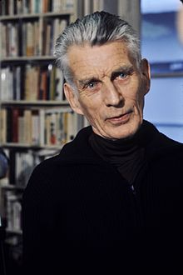
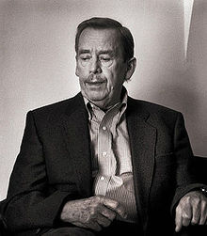
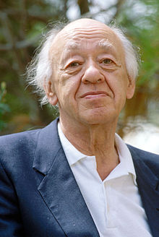
Famous writers of the theatre of the absurd included Samuel Beckett (Waiting for Godot), Vaclav Havel, Tom Stoppard, and Eugene Ionescu.
Many writers in the Theatre of the Absurd wrote in French.

Slide 6
When did modernism occur?
Modernism literary was produced between world war one and world war two.
Modernism came as a result of the World War I.
That war between European powers disillusioned many intellectual thinkers of the time.
Many started to scoff at “old-fashioned” ideas.

Slide 7
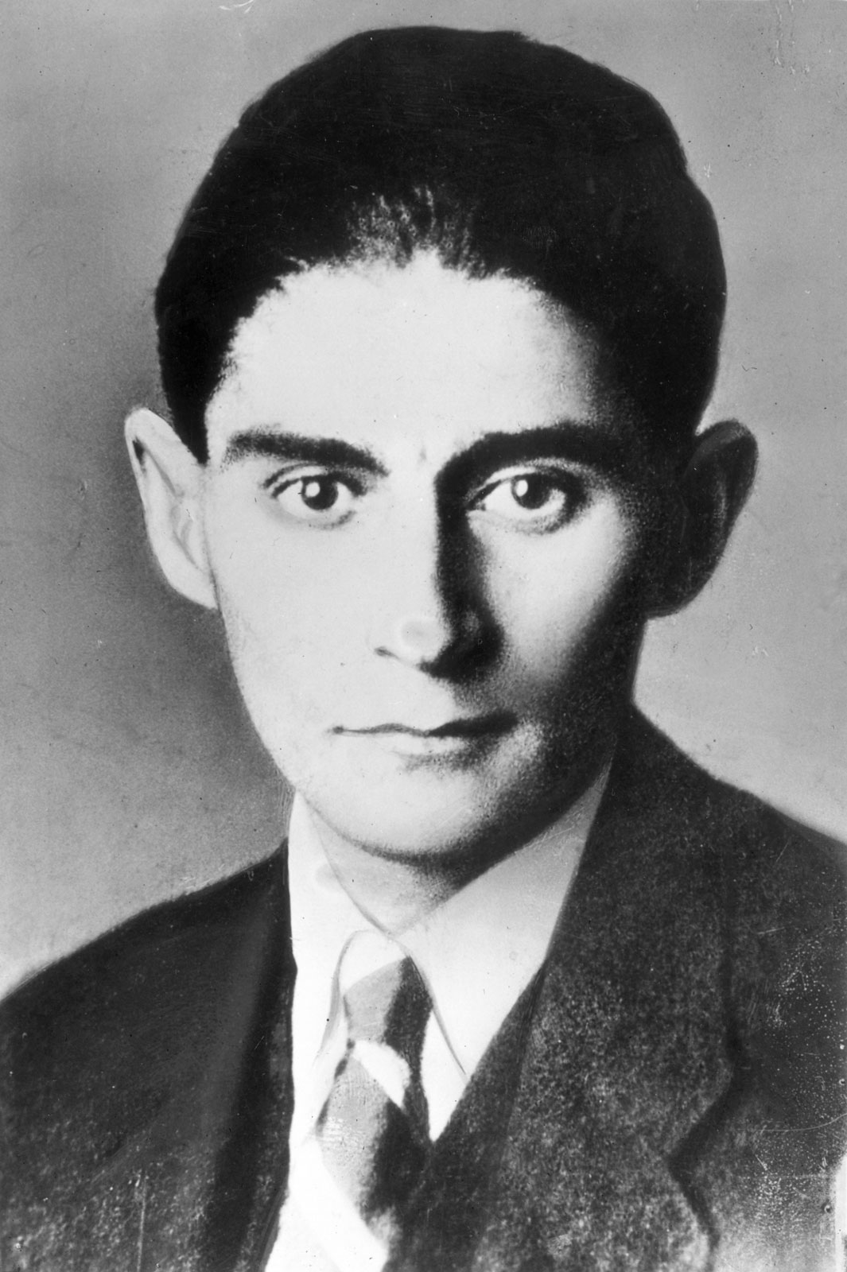
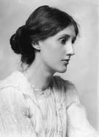
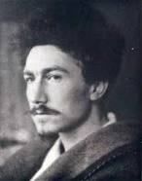
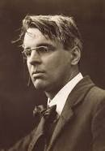
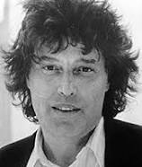
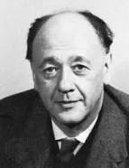
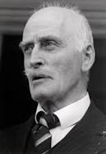
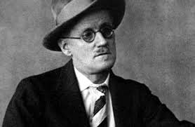
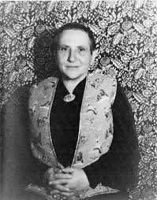
Famous modernists
Virginia Woolf
Ezra Pound
T. S. Eliot
Franz Kafka
W.B. Yeats
Eugene Ionescu
Tom Stoppard
Gertrude Stein
Knut Hamsun
James Joyce

Slide 8
Criticism of modernism
Many critics were turned off from the heavy, nonsensical prose in modernism.
The Waste Land, by T. S. Eliot, angered many at the time of its productions.
Many people were also disgusted by modernism’s obsession with fascism.

Slide 9
Pros of modernism
Modernism came along the time of the Harlem Renaissance.
Many writers such as Langston Hughes and Gertrude Stein wrote about painful experiences growing up oppressed.
This led many Americans to support the civil rights movement.

Slide 10
Modernism
Modernism was also directly influenced by the previous century.
Back then, almost all books used complicated, flowerly language.
Modernism condensed knowledge and presented it as is.
As a result, most books today are directly descended from Modernist style.

Slide 11
The end of Modernism
Modernism ended around the time WWII started. With the economies of European states booming, many no longer felt the need to be pessimistic.

Slide 12
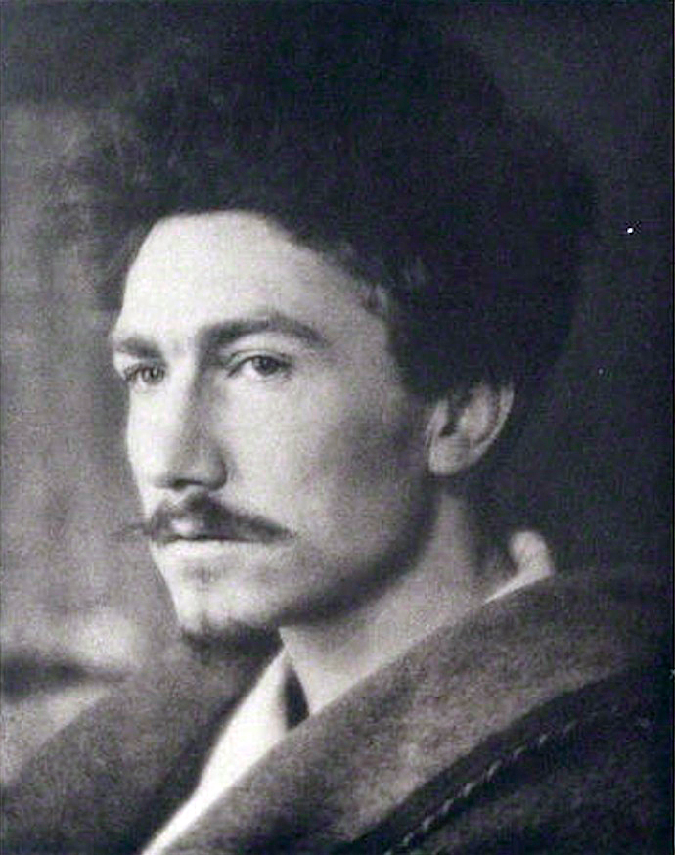
Make It New!

Slide 13
Bibliography
Kuiper, Kathleen. "Modernism | Art." Encyclopedia Britannica Online. Encyclopedia Britannica, 20 Aug. 2014. Web. 02 Mar. 2015.
Green, Ellie. "Overview of Literary Modernism: Authors, Context, and Style."Education Portal. N.p., n.d. Web. 03 Mar. 2015.
"History of Modernism." History of Modernism. N.p., n.d. Web. 02 Mar. 2015.
Modernism." - Literature Periods & Movements. N.p., n.d. Web. 11 Feb. 2015.
"Modernism and the Modern Novel." Modernism and the Modern Novel. N.p., n.d. Web. 02 Mar. 2015.

