Slide 1
Neoclassicism
by: Ruth Abraham, Sara Ahmed, Sydney Nguyen

Slide 2
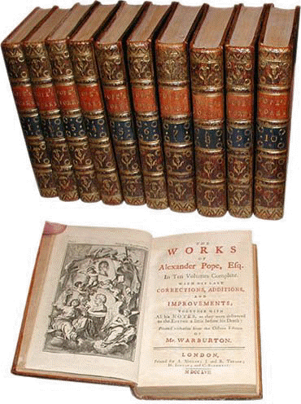
Neoclassicism = New Classical

Slide 3
What is Neoclassicism?
Neoclassicism refers to the art or literature produced later but is inspired by antiquity.
This period of time was considered neoclassical because writers would look back to the literature of classical times
Ended in 1800’s because people began emphasizing the individual rather than how a person contributed to and fitted into a society

Slide 4
When did Neoclassicism Begin?
Neoclassicism began in Europe in the 1700’s and lasted until the 1800’s
Mostly used in France and England.
Gradually declined over the years.
Influenced Romanticism.

Slide 5
Neoclassical Periods
Restoration Period- 1660 to 1689, when King Charles the II was restored to the throne.
Augustan Period- Period of Roman history when Augustus what the emperor.
Age of Johnson- 1709-1784 Era where Samuel Johnson was very influential in Neo Classical arts

Slide 6
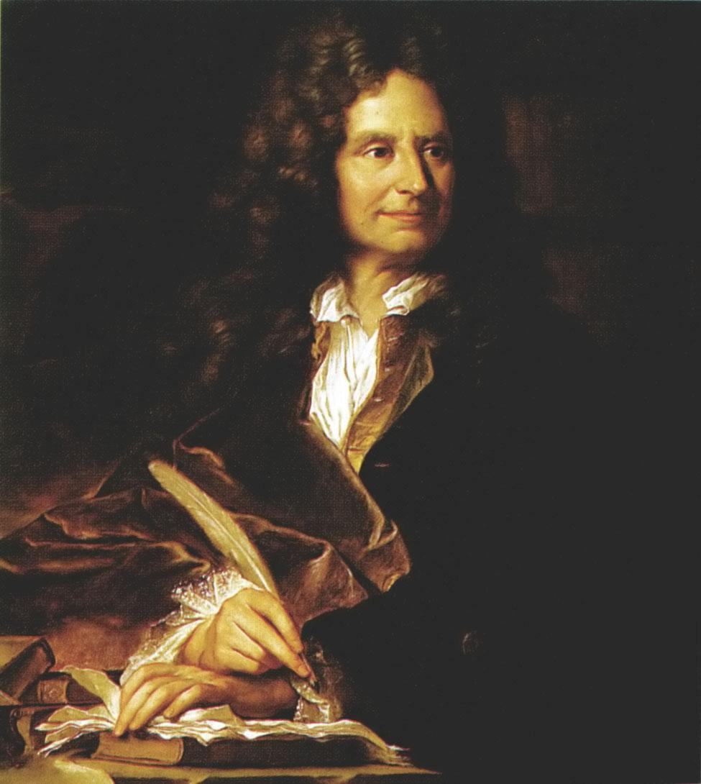
Founder of Neoclassicism
Boileau- (French) emphasized that people should write and criticize following the rules of reason.

Slide 7
Characteristics of Neoclassicism
Neo-classical critics aspire to stay true to human nature.
Correctness, accuracy, sound reason, structure and order are terms to associate with the era.
Word choice was held to a high standard.

Slide 8
How do neoclassical writers/critics think?
Neoclassical writers/critics compare the works of the past to determine the value of the work in the present.
They believe that human nature is constant no matter the time or place.
Neoclassical writers/critics feel that art represent the uniformity in human nature

Slide 9
Associated Authors
English writers
Alexander Pope- influenced by Boileau translated The Iliad
John Milton- Paradise Lost
Jonathan Swift- known for satire works including Gulliver's Travels

Slide 10
Sources
http://www.victorianweb.org/previctorian/nc/ncintro.html
http://www.britannica.com/EBchecked/topic/120317/Classicism-and-Neoclassicism
http://academic.brooklyn.cuny.edu/english/melani/cs6/neocl.html
http://educationcing.blogspot.com/2012/07/neo-classical-criticism.html
http://www.wisegeek.org/what-is-neoclassical-literature.htm
http://www.britannica.com/EBchecked/topic/343487/literary-criticism/51228/Neoclassicism-and-its-decline
https://mashrabiyya.wordpress.com/2011/05/06/art-101-what-is-neoclassicism/
http://education-portal.com/academy/lesson/neoclassical-literature-definition-characteristics-movement.html

