Slide 1
Neoclassicism
By: Chase Mesh and Jared Rose

Slide 2
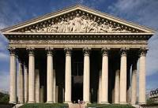
What is Neoclassicism?
Neoclassicism began in 1660 and was common through the
eighteenth century.
It all started in Rome and spread to France. From France it spread all over Europe.
Neoclassicism was not just literature but was art architecture,music, and theater.

Slide 3
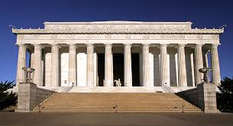
Modern Works of Neoclassicism
Capitol Building
Lincoln Monument

Slide 4
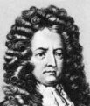
Daniel Delfor
Daniel Delfor was one of the most famous writers during this time writing over 2500 works.
He is know as the father of the modern novel.

Slide 5
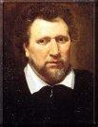
Ben Johnson
Ben was a poet and actor during this time.
known as the founder of “comedy and humours

Slide 6
Neoclassicism Now
literary classicism has died down since the end of the 1800s
There are still works of art made that resemble the time period of classicism

Slide 7
References
http://www.identifythisart.com/art-movements-styles/pre-modern-art/neoclassical-art-movement/
http://dictionary.reference.com/browse/neoclassicism
http://writershistory.com/index.php?option=com_content&task=view&id=578&Itemid=39
http://writershistory.com/index.php?option=com_content&task=view&id=589&Itemid=39

