Slide 1
New Criticism
By: Allison Barfield, Lindsey Gaston, Michael Lennen, and Alex Waters

Slide 2
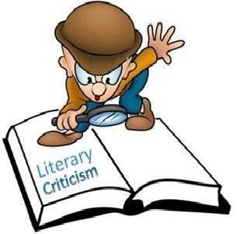
Literary Criticism
Literary Criticism is the study, evaluation, and interpretation of literature and is informed by theory.

Slide 3
Literary Theory
Literary Theory is the systematic study of the nature of literature and the methods for analyzing literature.

Slide 4
What is New Criticism?
Started in the middle of the 20th century
Emphasizes close reading
Particularly for poetry/ short stories
Used to discover how a piece of literature functions as an aesthetic object
Looks at the literal words written
Does not look at the author or biographical issues

Slide 5
Scholars Involved
John Crowe Ransom- author, educator, and literary critic seen as the founder of new criticism from his 1941 book The New Criticism
Ivor Armstrong (I.A.) Richards- considered father of new criticism due to his first two books of critical theory: The Principles of Literary Criticism and Practical Criticism

Slide 6
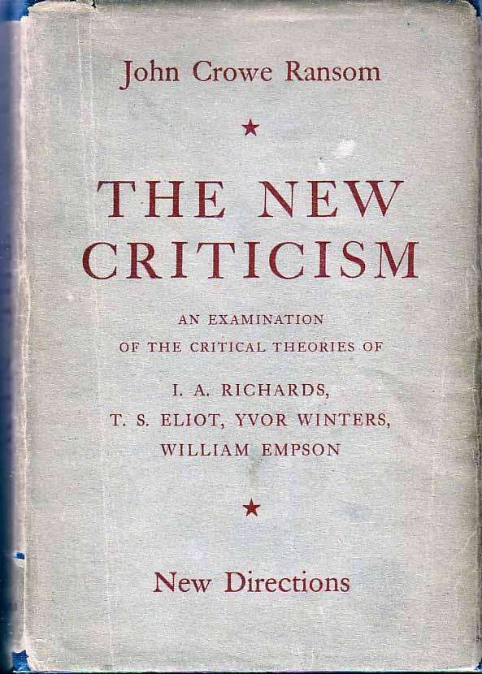
A picture of John Crowe Ransom’s book, The New Criticism

Slide 7
Scholars Involved (cont.)
T.S. Eliot- Poet who made significant contributions to the field of literary criticism through his works by giving a cue to new critics
Allen Tate- The subject of Tate's own interpretive essay "Narcissus as Narcissus" (1938), itself is a model of the New Criticism.

Slide 8
Scholars Involved (cont.)
Cleanth Brooks- A central figure of New Criticism that advocates close reading because, as he states in The Well Wrought Urn, "by making the closest examination of what the poem says as a poem" (Leitch 2001), a critic can effectively interpret the text
William Empson- impacted new criticism through his work Seven Types of Ambiguity

Slide 9
Our Sources
http://public.wsu.edu/~delahoyd/new.crit.html
http://www.textetc.com/criticism/the-new-criticism.html
http://education-portal.com/academy/lesson/new-criticism-in-literature-definition-examples-quiz.html
http://bcs.bedfordstmartins.com/virtualit/poetry/critical_define/crit_newcrit.html
https://owl.english.purdue.edu/owl/resource/722/03/
http://www.shmoop.com/new-criticism/
http://www.poetryfoundation.org/bio/william-empson

