Slide 1
New Criticism
Jahmil Jno-Finn, Jonah Dodson, Alex Mitchell
Tidbits of Bad Taste DEFINITELY NOT provided by Ansel Ahabue
Minimalist Penguins Inc.

Slide 2
What is New Criticism?
New Criticism is the analysis of a piece based only on the words on the page.
Author's life or intentions are unimportant and will be ignored
Critics do not bring in their own personal opinions, or anything that exists outside of the story
The piece is read without any biases (it is objective).

Slide 3
What is New Criticism cont.
Essentially “how the piece works” based only on the piece
Argues that texts have everything required to understand them within the text
Focus on literary devices like irony, paradox, and metaphors

Slide 4
History
Envisioned in the first half of the 20th century.
People began to believe that the purity of poems was stained by the
introduction of extraneous information
First developed in the United States with people like John Crowe Ransom and his students at Vanderbilt University.

Slide 5
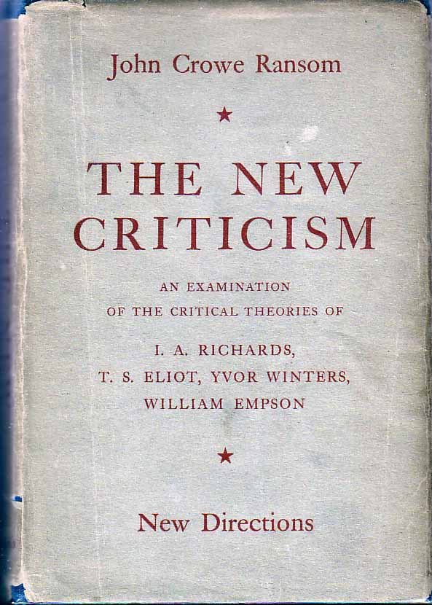
Figures in New Criticism
T.S. Elliot wrote two famous essays, titled “Tradition and the Individual Talent” and “Hamlet and His Problems.”
I.A. Richards, Yvor Winters, and William Empson are also important
Robert Penn Warren, and John Crow Ransom started the movement for this type of criticism

Slide 6
Examples
For example, one would analyze a Poe work not by analyzing his life, but by simply examining the life displayed on the page
In Hills Like White Elephants, we may not focus on the cultural issues, but one would display interest in the meaning of the dialogue through the character’s actions.

Slide 7
Works Cited
http://www.shmoop.com/new-criticism/
"New Criticism". Encyclopædia Britannica. Encyclopædia Britannica Online.
Encyclopædia Britannica Inc., 2015. Web. 02 Mar. 2015
http://www.britannica.com/EBchecked/topic/411305/New-Criticism
http://www.poetryfoundation.org/learning/glossary-term/new%20criticism
http://public.wsu.edu/~delahoyd/new.crit.html
http://faculty.goucher.edu/eng215/New_Criticism_terms.htm

Slide 8
Press ESC to exit
fullscreen mode
Oh, and one more thing...

Slide 9
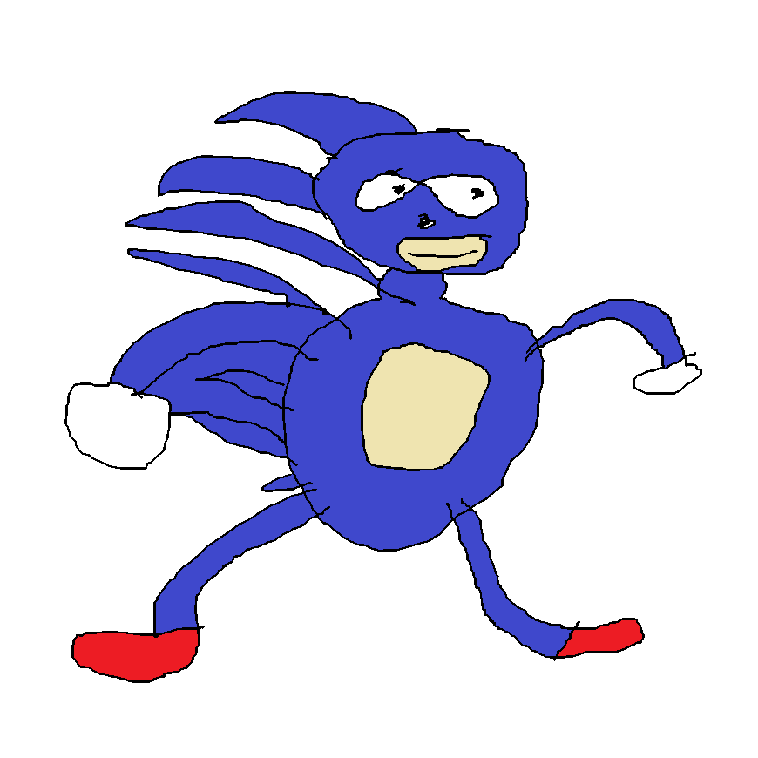
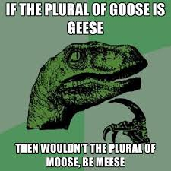
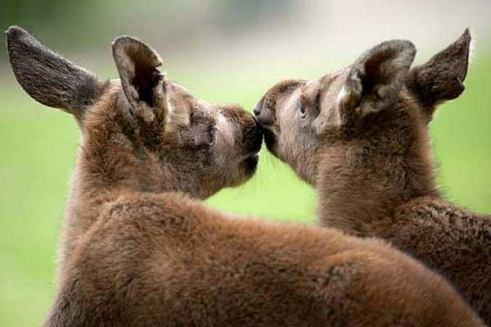
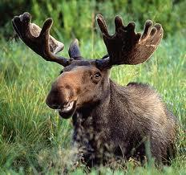
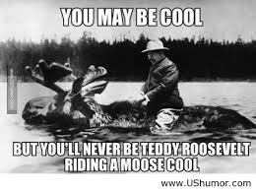
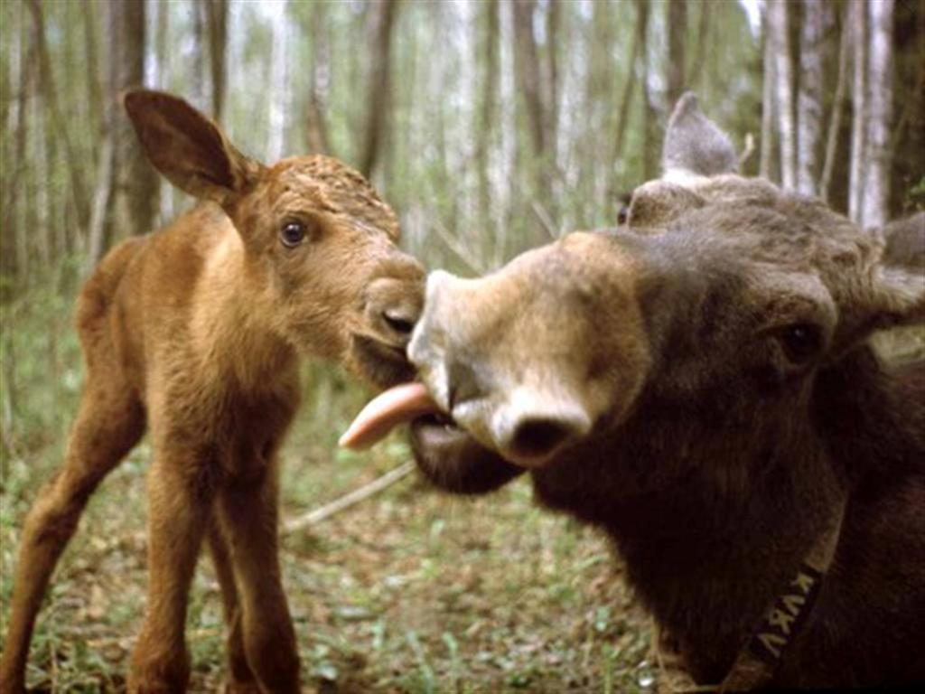
mm breh you smell fine
stop bruh das gey
do i smell grass?

Slide 10
The End

