Slide 1
Postcolonialism
Craig, Matt, Michael, Zach

Slide 2
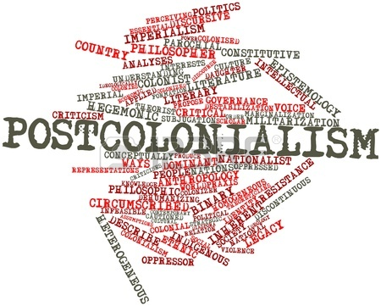
Definition
Postcolonialism is looking at a text from a viewpoint against the ideas of colonialism/imperialism.

Slide 3
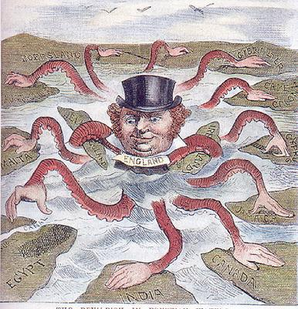
When It Started
It was started around 1950 and is still very present today
The writing of postcolonialism has been around for hundreds of years but the true criticism of the type of literature just recently started in the last 40-50 years.

Slide 4
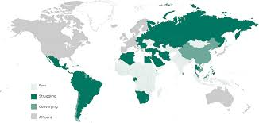
Status Today
Postcolonialism is very popular today especially in places such as Africa, and the Middle East because both these regions have experienced large amounts of outside control and have made many volumes of literature about breaking away and becoming independent.

Slide 5
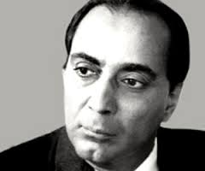
Founders
There is no specific founder but these people helped spread the ides of postcolonialism
Edward Said - Orientalism, 1978; Culture and Imperialism, 1994
Kamau Brathwaite - The History of the Voice, 1979
Gayatri Spivak - In Other Worlds: Essays in Cultural Politics, 1987
Chinua Achebe - Things Fall Apart, 1958
Homi Bhabha - The Location of Culture, 1994

Slide 6
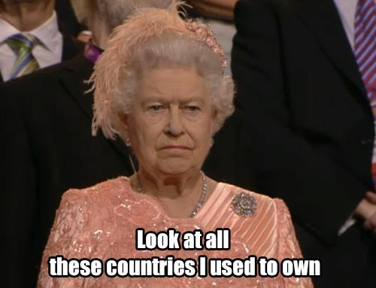
Why It Was Made
Made because of minorities rising up and saying that what their colonizers believed was wrong
Example: Nelson Mandela and the disagreement of apartheid.

Slide 7
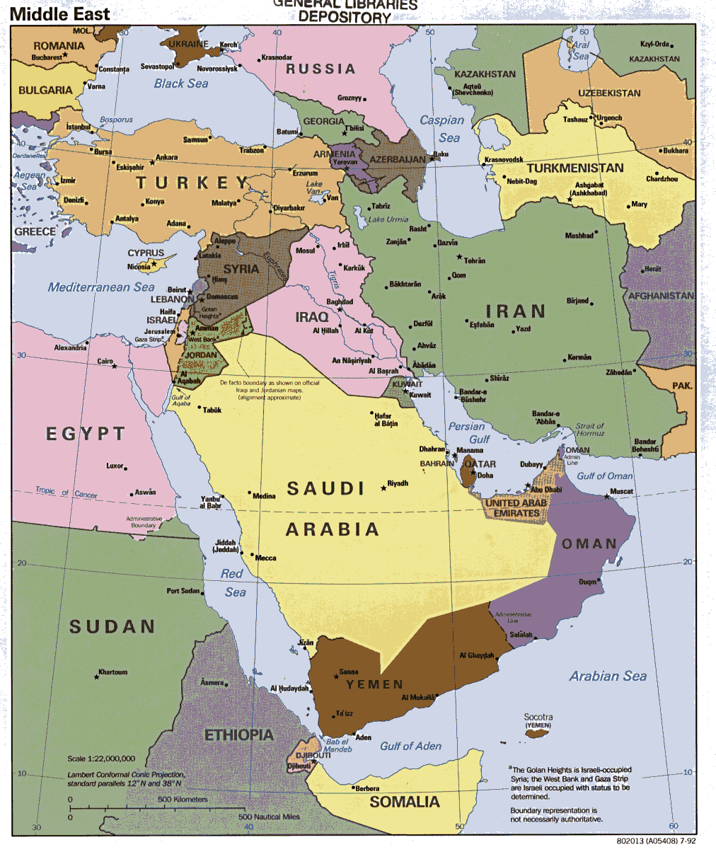
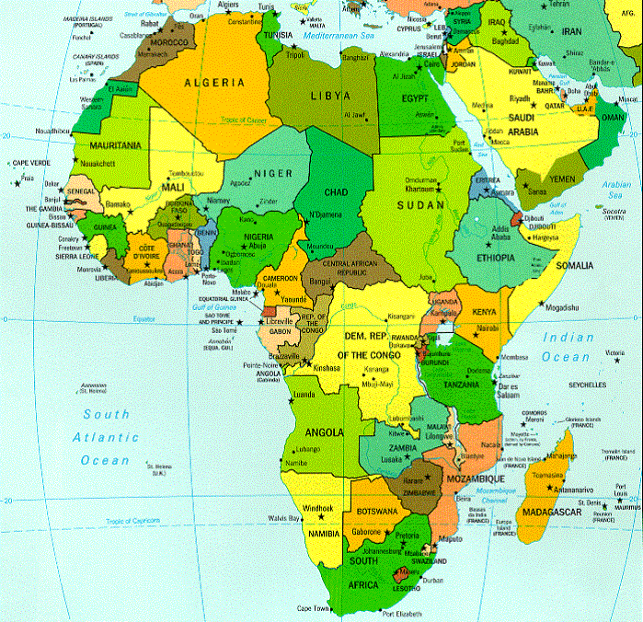
Promoters Today
The main countries that promote most of the Postcolonial ideas are some countries in The Middle East and some in Africa. They are all basically just the countries that the European countries settled.

Slide 8
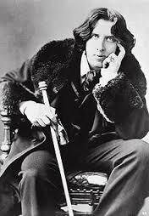
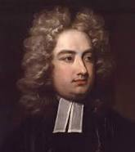
Famous Authors
Jonathan Swift (in The Victorian Web) Ireland
Oscar Wilde, (in The Victorian Web) from Ireland, was a very popular poet and story maker who wrote large volumes of literature about escaping from British Colonial Rule.
Kazuo Ishiguro from UK.
Oscar Wilde
Kazuo Ishiguro
Jonathan Swift

Slide 9
Basic Beliefs, What We Look For
The issues of power, economics, politics, religion, and culture and how these work to show the controlling of the colonizer and the colony.
It is the rejection of the colonialist beliefs

Slide 10
Bibliography
https://owl.english.purdue.edu/owl/resource/722/10/
http://education-portal.com/academy/lesson/post-colonialism-in-literature-definition-theory-examples.html
http://bcs.bedfordstmartins.com/virtualit/poetry/critical_define/crit_post.html
http://humanities.wisc.edu/assets/misc/What_is_Postcolonial_Literature_.pdf
http://2.media.dorkly.cvcdn.com/13/89/336a28215c215237ff39636e06e035cb.gif
http://media.moddb.com/cache/images/downloads/1/35/34686/thumb_620x2000/v7cjyb.gif
http://www.postcolonialweb.org/misc/authors.html
Notes:
hi

