Slide 1
Postcolonial Criticism
By: Robert Scott and Kaleb Alvarado

Slide 2
Background
Post-colonial critics are concerned with literature produced by colonial powers and works produced by those who were/are colonized.
It discusses the impact left by colonizers on the land colonized.
Postcolonial criticism was started in the 1990’s and continues as a school of thought today.
Post-colonial criticism also takes the form of literature composed by authors that critique Eurocentric hegemony.

Slide 3
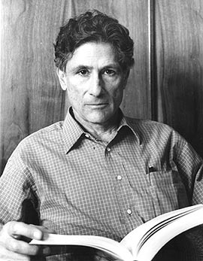
Key Founders
Edward Said
Main founder
Professor at Columbia University
Born in Palestine
works Orientalism, 1978; Culture and Imperialism, 1994
Gayatri Spivak
In Other Worlds: Essays in Cultural Politics, 1987
Homi Bhabha
The Location of Culture, 1994

Slide 4
Authors Associated
Chinua Achebe
Things Fall Apart
Ngũgĩ wa Thiong'o
Decolonising the Mind
Mohammed ben Abdallah

Slide 5
Stages
An initial awareness of the social, psychological, and cultural inferiority enforced by being in a colonized state
The struggle for ethnic, cultural, and political autonomy
A growing awareness of cultural overlap and hybridity

Slide 6
Beliefs
Postcolonial critics study the colonization and who they were oppressing.
They look for the impact the colonization left on history and the native culture.

Slide 7
Sources
https://owl.english.purdue.edu/owl/resource/722/10/
http://en.wikipedia.org/wiki/Edward_Said
http://www3.dbu.edu/mitchell/postcold.htm
http://www.postcolonialweb.org/misc/authors.html

