Slide 1
Psychoanalysis
By: Fasica Mersha, Cxan Burton, Felina Thomas

Slide 2
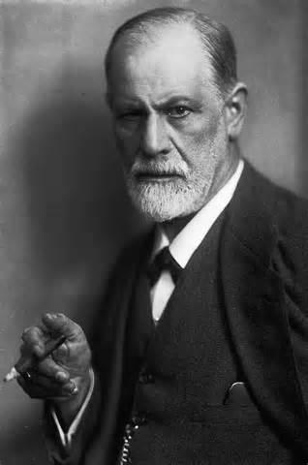
Introduction
Started by Sigmund Freud, one of the earliest psychologists
Psychoanalysis literary criticism was a reaction to the psychoanalytic principles developed by Sigmund Freud.
Looks at the unconscious and conscious mind of the author or character

Slide 3
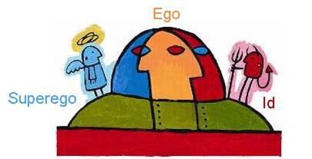
Id, Ego, and Superego
Id: instinctive component of personality present from birth; focuses on pleasure principle
Ego: modified by direct influence of external world; focuses on reality principle
Superego: develops around age 5; controls Id’s impulses; moral standards acquired from parents and society
Ideal Self: Model behavior
Conscience: Guilty feelings

Slide 4
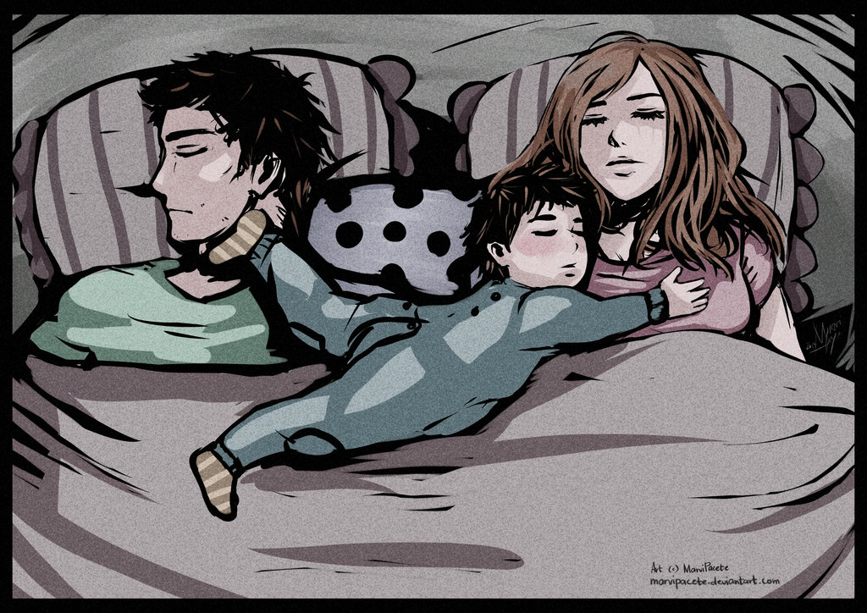
Oedipus Complex
Oedipus Complex is a desire for sexual involvement with someone similar to the parent of the opposite sex and a concomitant sense of rivalry with the parent of the same sex
Applied to children as they grow up
Men want wives/girlfriends like their mothers and women want husbands/boyfriends like their fathers
They compete for love

Slide 5
The Unconscious, the Desires, and the Defenses
The unconscious mind is made up of the irrational desires; Freud thought that childhood experiences dictated this. A person’s personality is based upon this.
A desire is described as a longing for something. This is different from emotion; emotion is based upon the mental state of someone. Desires are things that the body needs (eg. hunger or sleep)
The defenses are ways to cope with anxieties or harmful drives. Sigmund Freud believed that these were unconscious.

Slide 6
Beliefs
A person’s development is determined by events from their childhood.
Irrational drives greatly affect human attitude, mannerism, experience, and thought.
Irrational drives are unconscious.
Trying to bring these irrational drives to awareness meets defense mechanisms as psychological resistance.
Conflicts between conscious and unconscious material can form mental and emotional disturbances. (Anxiety, depression, etc.)
Liberation from unconscious material can be achieved through bringing the material into the conscious mind. (Skilled guidance, therapeutic intervention, etc.)

Slide 7
Authors
Jacques Lacan was a post-freudian author who treated the unconscious as a language (rather than as a form or repression).
He believed that human passion depends on the desires of others and we (as humans) express deep emotions due to the shift of others.
Carl Jung is also relevant; he was a student of Sigmund Freud and is best.
He is given credit for developing the basis for the dream analysis, the collective unconsciousness, and studying the human psyche, and archetypes (models of people).

Slide 8
Bibliography
http://education-portal.com/academy/lesson/psychoanalysis-theory-definition-lesson-quiz.html
https://owl.english.purdue.edu/owl/resource/722/04/
https://www.boundless.com/psychology/textbooks/boundless-psychology-textbook/personality-16/psychodynamic-perspective-on-personality-77/freud-s-psychoanalytic-theory-of-personality-304-12839/
http://public.wsu.edu/~delahoyd/psycho.crit.html
http://bcs.bedfordstmartins.com/virtualit/poetry/critical_define/crit_psycho.html
http://www.simplypsychology.org/psyche.html
http://www.britannica.com/EBchecked/topic/425451/Oedipus-complex
Schacter, Daniel L. (2011). Psychology Second Edition. 41 Madison Avenue, New York, NY 10010: Worth Publishers. pp. 482–483.

