Slide 1
Queer Theory
By: Michele Presmy, Nile Ravenell, Briana Wood

Slide 2
What is Queer Theory
Queer theory is a set of ideas based around the idea that identities are not fixed and do not determine who we are. It is anything that has to do with with sexuality and identity. The queer theory stems from feminism and gay/lesbian studies. It suggests that it is meaningless to talk in general about 'women' or any other group, as identities consist of so many elements that to assume that people can be seen collectively on the basis of one shared characteristic is wrong.

Slide 3
Basics of Queer Theory
The queer theory is fairly new so there the basics of the theory are still being formed. However, the queer theory is used in books to provide clues at the characters sexuality. Hints at feminine characteristics for a male character, or masculine characteristics for a female character, expresses the stereotypical homosexual.

Slide 4
Who Founded Queer Theory
The term “queer theory” was developed in the 1990s by Italian feminist and film theorist, Teresa de Lauretis, for a conference she organized at the University of California, Santa Cruz.
It was also defined by Glen Elder, Lawrence Knopp, and Heidi Nast.

Slide 5
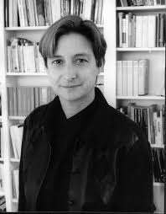
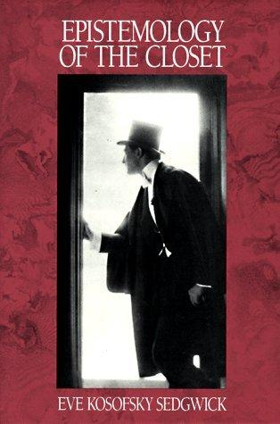
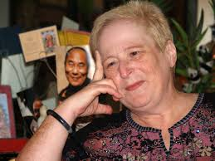
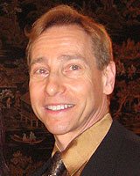
Queer Theory Authors
Judith Butler
Gender Trouble
Eve Kosofsky Sedgwick
Epistemology of the Closet
Lee Edelman
No Future: Queer Theory and the Death Drive

Slide 6
Gay/Lesbian Criticism vs Queer Theory
Gay and Lesbian criticism focuses on gender (man vs. woman) in oppose to Queer Theory, which focuses on all sexual preferences/identities, hence the term queer.

Slide 7
The end

Slide 8
Sources
http://www.theory.org.uk/ctr-que1.htm
http://www.shmoop.com/queer-theory/
http://www.glbtq.com/literature/lit_theory,3.html
http://www.goodreads.com/shelf/show/queer-theory
https://owl.english.purdue.edu/owl/resource/722/12/
http://www.sjsu.edu/faculty/harris/Eng101_QueerDef.pdf

