Slide 1
Queer Theory
Ethan Clark and Emily Rubin

Slide 2
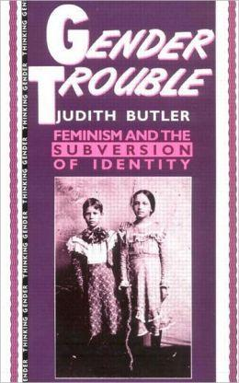
History
Started in 1970
Didn’t take off until 1990
Grew in popularity at the same rate the word “queer” did

Slide 3
Judith Butler
Professor at University of California, Berkeley
Wrote many articles on queer theory
Argued her positive opinions on queer theory and negative opinions on feminism

Slide 4
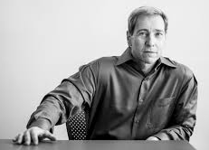
Lee Edelman
Author born in 1953
English professor at Tufts University
Some of his current works focus on sexuality
Wrote about the Queer theory and gained recognition for it

Slide 5
Beliefs
Queer Theory’s basic beliefs are that people are born with a set sexuality.
When looking at a work of writing through Queer Theory, one looks at the sexual tendencies of a character.
Queer Theory also examines the minority group.

Slide 6
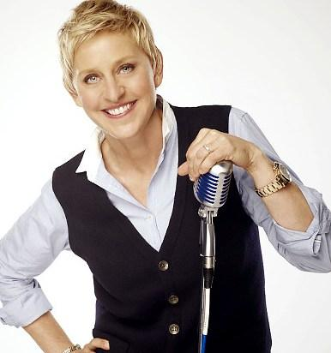
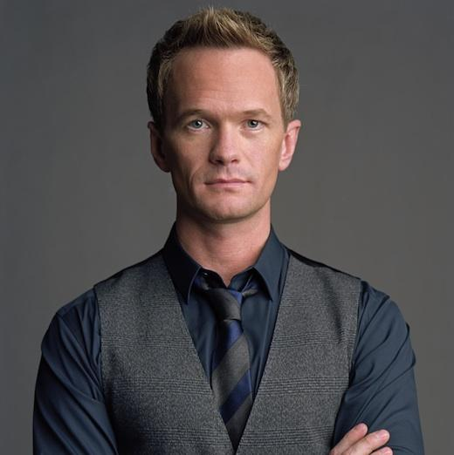
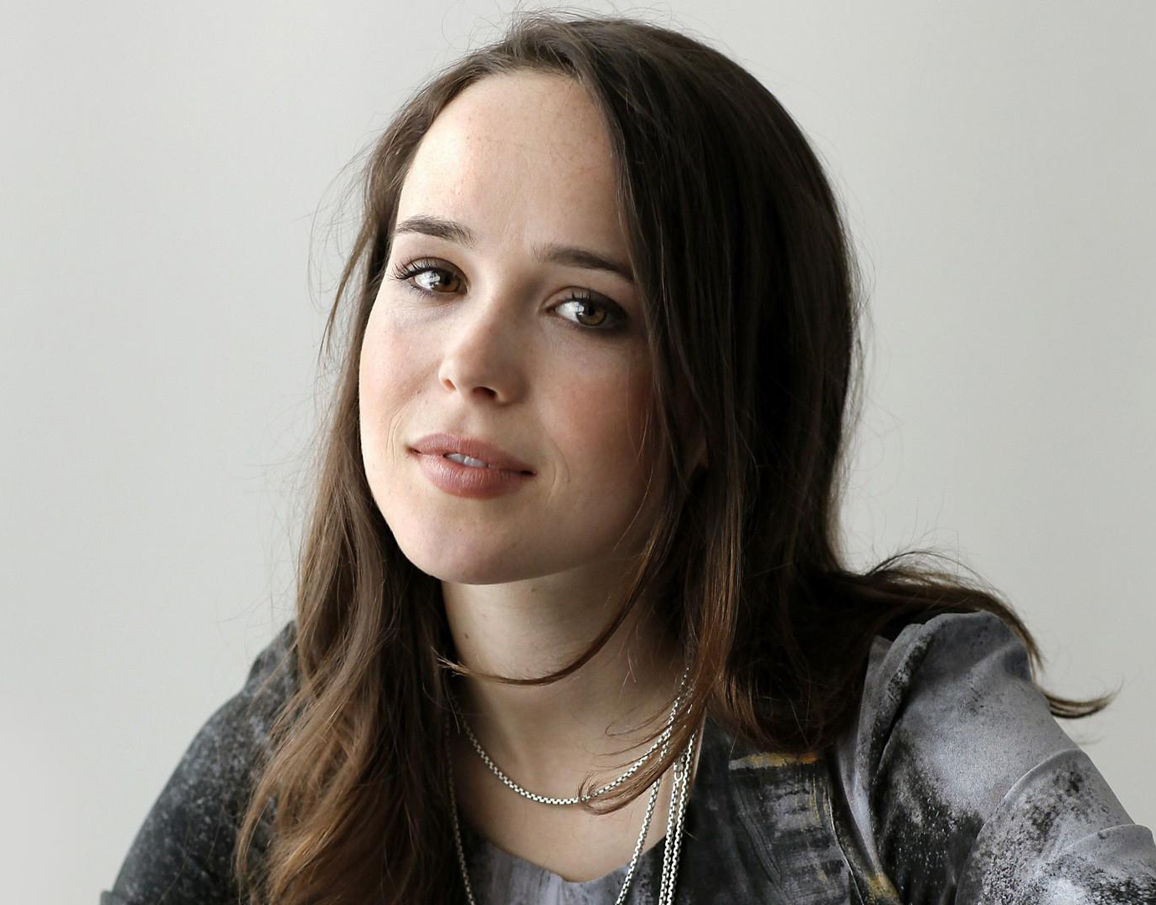
Famous Homosexuals
Queen Ellen
King Neil
Prince Tyler
Princess Page

Slide 7
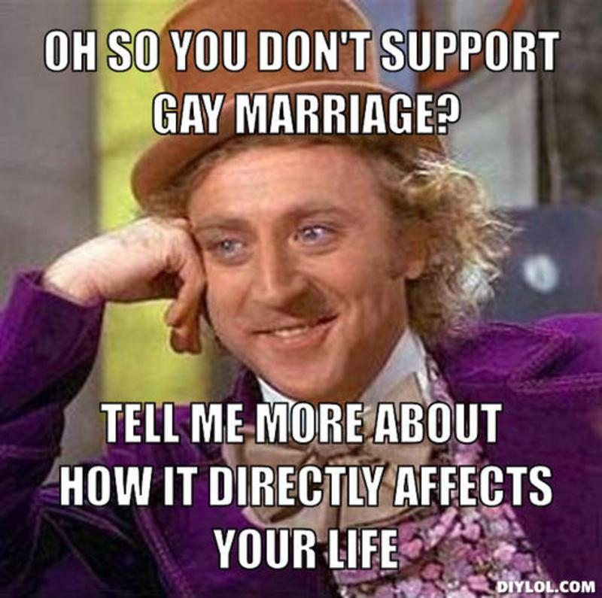
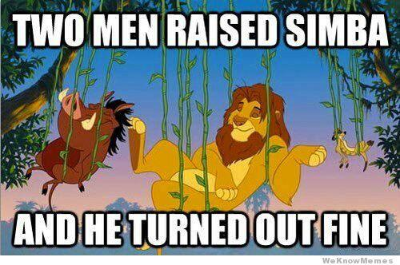
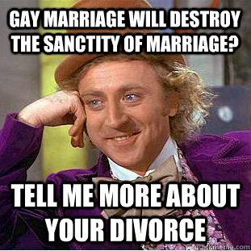
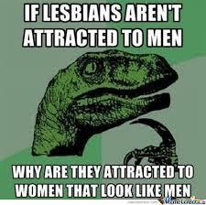
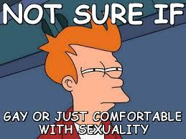

Slide 8
References
Brizee, Allen, and J. C. Tompkins. "Welcome to the Purdue OWL." Purdue OWL: Literary Theory and Schools of Criticism. Purdue University, n.d. Web. 03 Mar. 2015.
Gauntlett, David. "Www.theory.org.uk Resources: Judith Butler." Www.theory.org.uk Resources: Judith Butler. N.p., 1998. Web. 03 Mar. 2015.
Gauntlett, David. "Www.theory.org.uk Resources: Queer Theory." Www.theory.org.uk Resources: Queer Theory. N.p., 1998. Web. 02 Mar. 2015.
Jagose, Annamariel. "Queer Theory." Queer Theory. University of Melbourne Press, 1996. Web. 03 Mar. 2015.
"Queer Theory." Queer Theory. N.p., n.d. Web. 03 Mar. 2015.

