Slide 1
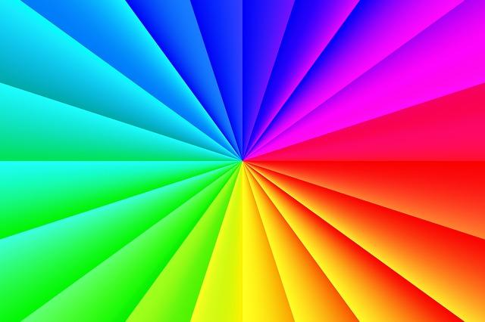
Queer Theory
Liesl, Brandy, Erin, & Emily

Slide 2
What Is It?
Queer
/kwir/
adjective
strange; odd (Wikipedia definition)
homosexual (Wikipedia definition)
noun
a homosexual man (Wikipedia definition)
an umbrella term sometimes used by LGBTQA people to refer to the entire LGBT community. (Definition from international+LGBT at the University of Michigan)
L- lesbian
G- gay
B- bisexual
T- transgender
Q- queer
A- asexual
(6 are listed here, but there are more)

Slide 3
Basic Tenets Of Belief
Queer theorists challenge the assumption that gender and sexual preference are fixed things.
Sexuality is socially constructed and varies with context.
Each sexuality comes with its own characteristics.
The human body may not be essentially male or female.
Support all sexualities

Slide 4
Methods Of Criticism
Asks questions such as:
What elements of the text are “masculine” or “feminine” (forceful or passive)
What are the personalities of characters?
How are queer experiences encoded into the text if the author is apparently homosexual?
How does the text display the problematics of sexuality and sexual “identity”?

Slide 5
Associated Years
1980s and 1990s- Queer theory began to emerge in reaction to feminist beliefs of the 1970s.
each sex comes with its own essential characteristics
1991- The term “Queer Nation” appeared on the cover of Outlook.
1991- Judith Butler published her book, Gender Trouble.
Argues that “biological” sexes are are as socially constructed as gender

Slide 6
Associated Authors
Ami Polonsky
Writes LGBTQA friendly novels.
Michael Foucault
Books explaining sexualities, and their history.
James Dawson
An openly gay author, writes advice books (about being gay.)
Michael Warner
Viewpoints on gay rights

Slide 7
Sources
http://changingminds.org/explanations/identity/queer_theory.htm
http://science.jrank.org/pages/10938/Queer-Theory-Origins-Queer-Theory.html
http://www.theory.org.uk/ctr-que1.htm
https://faculty.washington.edu/mlg/courses/definitions/queer.htm
https://owl.english.purdue.edu/owl/resource/722/12/
http://internationalspectrum.umich.edu/life/definitions

