Slide 1
Structuralism and Semiotics
1920’s - present
By: Madeline, Hana, Kelsie, and Sidney
kelsie sucks

Slide 2
Tenets of Belief
Theory of signs, or semiotics.
How language constructs our sense of reality.
Ferdinand Saussure saw language as the most important sign system, and he created a two-part model:
a signifier (signifiant) - the form the sign takes (the “verbal object”)
the signified (signifié) - the concept it represents
A sign can be anything which stands for something else.
Signification is what a sign means.
It depends on the relationship of the two parts of the sign: signifier and signified.

Slide 3
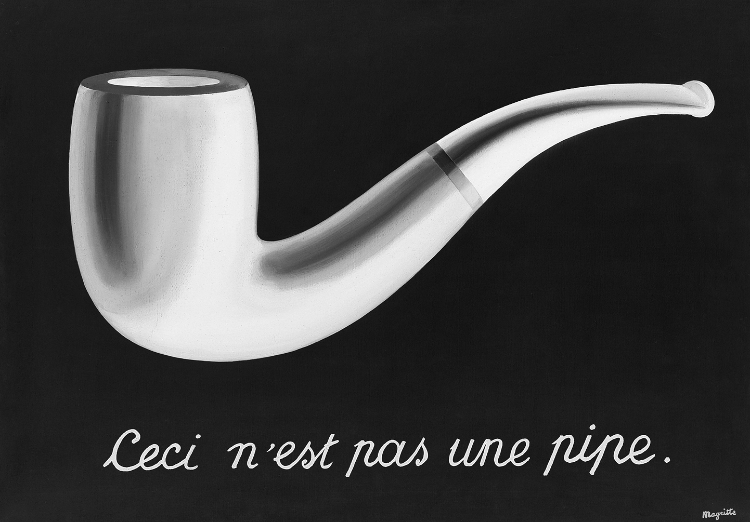
Founders/Example
Charles Sanders Peirce
Ferdinand de Saussure
An example of semiotics is Magritte’s Ceci N’est Pas Une Pipe, which translates to “This is not a pipe”, rather it is an image of a pipe. “It is neither a contradiction, a tautology, nor a necessary truth, since nothing can be a pipe and not a pipe at the same time.” - Gablik

Slide 4
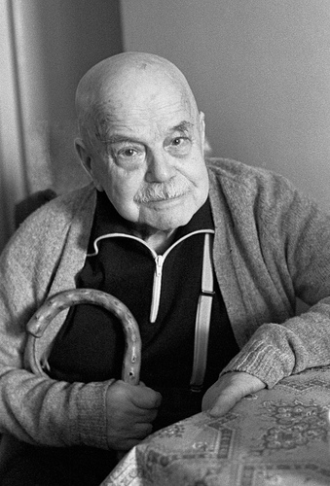
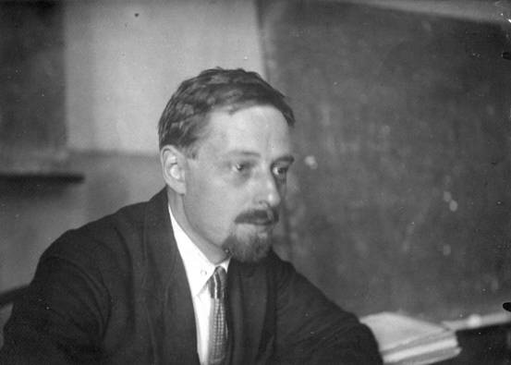
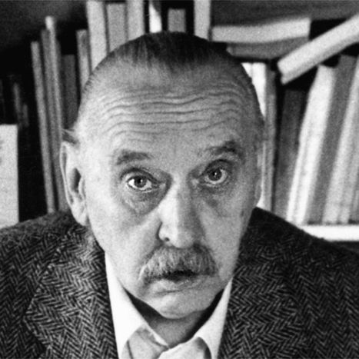
Authors
Early semiotic authors included
Vladimir Propp
Algirdas Julius Greimas
Viktor Shklovsky

Slide 5
Bibliography
Brizee, Allen, and J. Case Tompkins. "Welcome to the Purdue OWL." Purdue OWL: Literary Theory and Schools of Criticism. N.p., 19 Oct. 2011. Web. 3 Mar. 2015. <https://owl.english.purdue.edu/owl/resource/722/07/>.
"Media - Critical Perspectives." Media - Critical Perspectives. N.p., 15 Apr. 2013. Web. 03 Mar. 2015. <http://mandeepmedia.blogspot.com/>.
"Semiotics and Structural Analysis." Semiotics and Structural Analysis. N.p., n.d. Web. 03 Mar. 2015. <http://www.westga.edu/~mmcfar/semiotics_and_structural_analysi.htm>.
"Semiotic Literary Criticism." Wikipedia. Wikimedia Foundation, 16 June 2014. Web. 03 Mar. 2015. <http://en.wikipedia.org/wiki/Semiotic_literary_criticism>
Viktor Shklovsky. Digital image. N.p., 23 Aug. 2011. Web. 3 Mar. 2015. <http://bigother.com/2011/08/23/using-viktor-shklovsky/viktor-shklovsky-2/>.
Why didn’t the helicopter date the jet?
Because it was too plane
-Kelsie Tran

